Slide 1
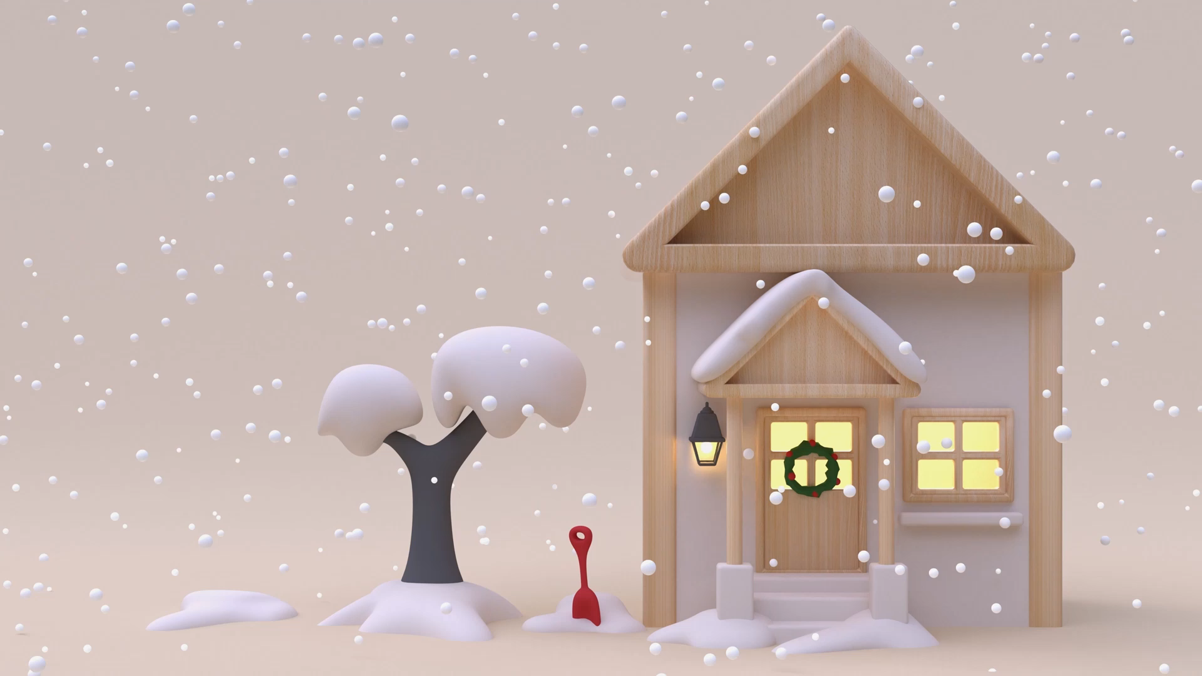
Active Christmas in Scoil Bhride

Slide 2

16 School Days left!

Slide 3

15 School Days Left! The Floor is Grinches- No standing on tables!

Slide 4

14 School days left!
Keep up the snow balls! Scrunch up a piece of paper and balance it on the back of your hand as you walk around the room to this song.

Slide 5

13 school days left!

Slide 6

12 School Days left!!

Slide 7
11 School days left!
Free Dance Break! Pick your favourite Christmas song and dance along!

Slide 8
10 School Days Left!
Choice: Pick your favourite activity that you’ve done so far!

Slide 9

9 School Days Left!

Slide 10

8 School Days Left!

Slide 11

7 School Days Left!

Slide 12

6 School Days Left!

Slide 13

5 School Days Left!

Slide 14

4 School Days Left!

Slide 15

3 School Days Left!

Slide 16
2 School Days Left!
Free Choice! Pick your favourite activity.

Slide 17

Last Day of School!

